Slide 1
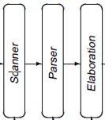
Construct Scanners
source
code
Front End
IR
Optimizer
IR
Back End
target
code
Last Lecture:
Today: minimized DFA -> Scanner
NFA
minimized DFA
Brzozowski’s algorithm

Slide 2
Converting a DFA into Executable Code
Three implementation strategies:
a table-driven scanner
a direct-coded scanner
hand-coded scanner.
All of these scanners operate in the same manner, by simulating the DFA.
They all have the same asymptotic complexity—constant cost per character, plus the cost of roll back.
They differ in the details of their constant costs per character but not the asymptotic complexity of scanning.

Slide 3
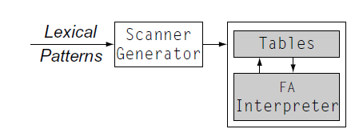
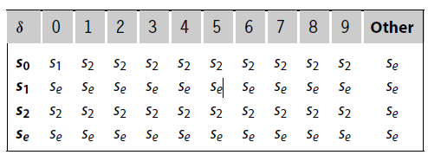
Table-Driven Scanners
The table-driven approach uses a skeleton scanner for control and a set of generated tables that encode language-specific knowledge.
Tables: transition table
…
Generating a Table-Driven Scanner

Slide 4
Table-Driven Scanners
A simplified skeleton
In practice, the skeleton is more complex
Character classification for table compression
Forming a string from the characters
Recording the “lexeme”
Recognizing sub-expressions
Practice is to combine all the REs into one DFA
Must recognize individual words without hitting EOF
NextWord()
state ← s_{0 ;}
while (state ≠ exit) do
char ← NextChar( ) // read next character in the input stream
state ← δ (state,char); // take the transition

Slide 5
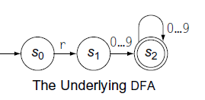
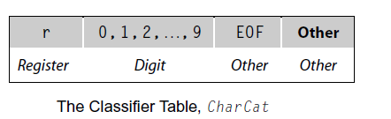
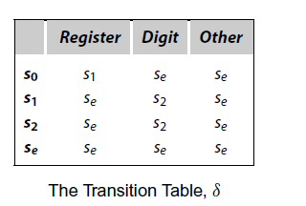
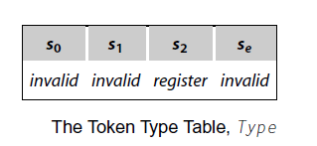
Table-Driven Scanners
Character Classification
Group together characters by their actions in the DFA
Combine identical columns in the transition table, δ
Indexing δ by a character’s class shrinks the table
NextWord()
state ← s_{0 ;}
while (state ≠ exit) do
char ← NextChar( ) // read next character
cat ← CharCat (char) // classify character, 0~9 are digit category
state ← δ (state, cat) // take the transition
Idea works well in ASCII (or EBCDIC): compact, limited range of values. Not clear how it extends to larger character sets (unicode)

Slide 6
Table-Driven Scanners
Forming a String with the Lexeme
Scanner produces syntactic category (part of speech), most applications want the lexeme (word), too
This problem is trivial: Save the characters
NextWord()
state ← s₀
lexeme ← empty string
while (state ≠ exit) do
char ← NextChar( ) // read next character
lexeme ← lexeme || char // concatenate onto lexeme
cat ← CharCat(char) // classify character
state ← δ (state,cat) // take the transition
Choose syntactic category based on the final state

Slide 7
Table-Driven Scanners
Choosing a Category from an Ambiguous RE
We want one DFA, so we combine all the REs into one
Some strings may fit RE for more than 1 syntactic category
Keywords versus general identifiers
[a-z]([a-z]|[0-9])* vs for| while
Would like to encode all of these distinctions into the RE & recognize them in a single DFA
Scanner must choose a category for ambiguous final states
Classic answer: specify priority by order of REs (return 1st one)
[a-z] is a lex notation for the letters ‘a’ through ‘z’ in ASCII collating sequence order.

Slide 8
Keywords Folded into the RE
The regular expression
for | while | ([a-z] ([a-z] | [0-9])* )
leads to a DFA such as
Need transitions from for and while into s₁₀
s₂
o
s₃
r
s₄
[a-z] | [0-9]
f
s₀
[a-e] | [g-v] | [x-z]
s₁₀
s₄ ⇒ “for”
s₉ ⇒ “while”
s₁₀ ⇒ general identifier
[a-z] | [0-9]
[a-z] | [0-9]
w
s₅
h
s₆
i
s₇
l
s₈
e
s₉

Slide 9
Table-Driven Scanners
Scanning a Stream of Words
Real scanners do not look for 1 word per input stream
Want scanner to find all the words in the input stream, in order
Want scanner to return one word at a time
Syntactic Solution: can insist on delimiters
Blank, tab, punctuation, …
Do you want to force blanks everywhere? in expressions?
Implementation solution, keep reading input until
Run into an error or EOF, back up to accepting state
Need the scanner to return token, not boolean
Token is < lexeme, Part of Speech > pair
Use a map from DFA’s final state to Part of Speech (PoS)
“for” ends in a final state that maps to for while “ford” ends in a final state that maps to identifier

Slide 10
Table-Driven Scanners
Handling a Stream of Words
// clean up final state
state ← pop()
while (state ∉ S_{A} and state ≠ bad) do
truncate lexeme
RollBack() //moves the input stream back by one character
state ← pop()
end while;
// report the results
if (state ∈ S_{A} )
then return <PoS(state), lexeme>
else return invalid
NextWord()
// recognize words
state ← s₀
lexeme ← “”
clear stack
push (bad)
while (state ≠ s_{e}) do
if state ∈ S_{A}
then clear stack
push (state)
char ← NextChar( )
lexeme ← lexeme + char
cat ← CharCat (char)
state ← δ (state,cat)
end while;
PoS: state → part of speech
Need a clever buffering scheme, such as double buffering to support roll back
S_{A} is the set of accepting (e.g., final) states) s_{e} is error state

Slide 11
Avoiding Excess Rollback
DFA for
ab | (ab)* c
s₀
a
Some REs can produce quadratic rollback
Consider ab | (ab)* c and its DFA
Input “ababababc”
s₀, s₁, s₂, s₃, s₄, s₃, s₄, s₃, s₄, s₅
Input “abababab”, , several lexems of “ab”
s₀, s₁, s₂, s₃, s₄, s₃, s₄, s₃, s₄, rollback 6 characters
s₀, s₁, s_{2,} s₃, s₄, s₃, s₄, rollback 4 characters
s₀, s₁, s_{2,} s₃, s₄, rollback 2 characters
s₀, s₁, s₂
This behavior is preventable
Have the scanner remember paths that fail on particular inputs
c
s₁
b
a
s₃
s₂
a
b
c
s₄
c
s₅
Not too pretty

Slide 12
Direct-Coded Scanners
Table-driven scanners make heavy use of indexing
Each lookup in CharCat or δ involves an address calculation and a memory operation
Fair amount of overhead work per character
Avoid the table lookups and the scanner will run faster
Alternative strategy: direct coding
Encode state in the program counter
Each state is a separate piece of code
Do transition tests locally and directly branch
Generate ugly, spaghetti-like code
More efficient than table driven strategy
Fewer memory operations, might have more branches
state ← s_{0 ;}
while (state ≠ exit) do
char ← NextChar( )
cat ← CharCat(char )
state ← δ(state,cat);
Code locality as opposed to random access in δ

Slide 13
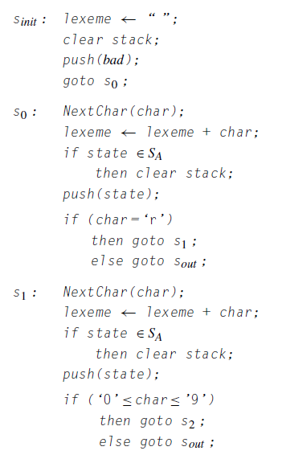
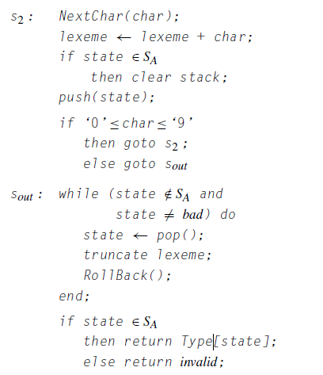
Building Faster Scanners from the DFA
A direct-coded recognizer for r [0…9]⁺
Fewer (complex) memory operations
No character classifier
Use multiple strategies for
test & branch

Slide 14
What About Hand-Coded Scanners?
Many modern compilers use hand-coded scanners
Starting from a DFA simplifies design & understanding
There are things you can do that don’t fit well into tool-based scanner
the compiler writer can use buffered i/o, where each read operation returns a longer string of characters, or buffer,
computing the value of an integer
alternative strategy of Handling Keywords: having the DFA classify them as identifiers and testing each identifier to determine whether or not it is a keyword

Slide 15
Building Scanners
The point
All this technology lets us automate scanner construction
Implementer writes down the regular expressions
Scanner generator builds NFA, DFA, minimal DFA, and then writes out the (table-driven or direct-coded) code
This reliably produces fast, robust scanners
Of course, not everything fits into a regular language …
⇒ which leads to parsing …

Slide 16
Project1 – scanner implementation

